Slide 1

Welcome
Welcome
Notes:
Topic: Mental Rehearsal
Time: 30 minutes
Purpose of training evolution: Sailors will explore the concept of mental rehearsal and its role in navigating challenging situations effectively.
Expected outcome of training evolution: Sailors will learn practical, mental rehearsal tools to visualize performing a skill or routine in their mind to successfully engage in real-world events and dispel complacency.
Safety: Inform Sailors of safety hazards in the training environment. For some topics, Sailors should be informed if there is a designated person to talk to if the Sailor feels compelled to leave the training.
Facilitator Actions:
Display slide.
Greet Sailors.
Introduce yourself and give any background on yourself that might be of interest.
Establish credibility.
Facilitator Instructions:
The slide deck acts as a guide to present a facilitated discussion that may include activities.
Best practice: Use the slide to develop interest in the subject matter. Do not read the slides word for word. The Sailors should be able read the text and understand the messaging presented in the graphics.
Facilitator notes are available for each slide to help the Facilitator deliver the topic.
Best practice: Use the Slide Show view to ensure the Facilitator notes are viewable.
The Facilitator notes are divided into general instructions for Facilitator Actions (mechanics of facilitation) and the Facilitator Content (Inform, Discuss, Perform, and Reference).
Best practice for Inform: Present facts, concepts, and procedures. Depending on the subject matter, these may be written as suggested talking points or scripted material (denoted by quotation marks).
Best practice for Discuss: Conduct large-group question and answer sessions or large-group, Facilitator-led activities. Depending on the subject matter, these may be written as questions with expected answers or scripted activities.
Best practice for Perform: Facilitate small-group, scenario-based or procedural activities. Depending on the subject matter, these may be written with specific actions the Sailors will take or general ways for the Facilitator to monitor the activities. The Facilitator will be provided with expected outcomes to ensure Sailors leave training with correct information.
Best practice for Reference: This is for Facilitator use only.

Slide 2
Introduction
Warrior Toughness
MIND • BODY • SPIRIT
Mental Rehearsal
Notes:
Facilitator Actions:
Display slide.
Introduce topic.
Let Sailors know that they can leave the discussion if they have to for their own well-being.
Ensure that misinformation is corrected immediately.
Monitor the discussions of the Sailors throughout the training event.
Facilitator Content:
Inform:
To build Warrior Toughness, Sailors will explore the concept of mental rehearsal and its role in navigating challenging situations effectively.
Sailors will learn practical, mental rehearsal tools to visualize performing a skill or routine in their mind to successfully engage in real-world events and dispel complacency.

Slide 3
Learning Objective
Use mental rehearsal to engage in real-world events and eliminate complacency.
Notes:
Facilitator Actions:
Display slide.
Neither Sailors nor Facilitator should read the objective out loud.
Facilitator Content: N/A

Slide 4
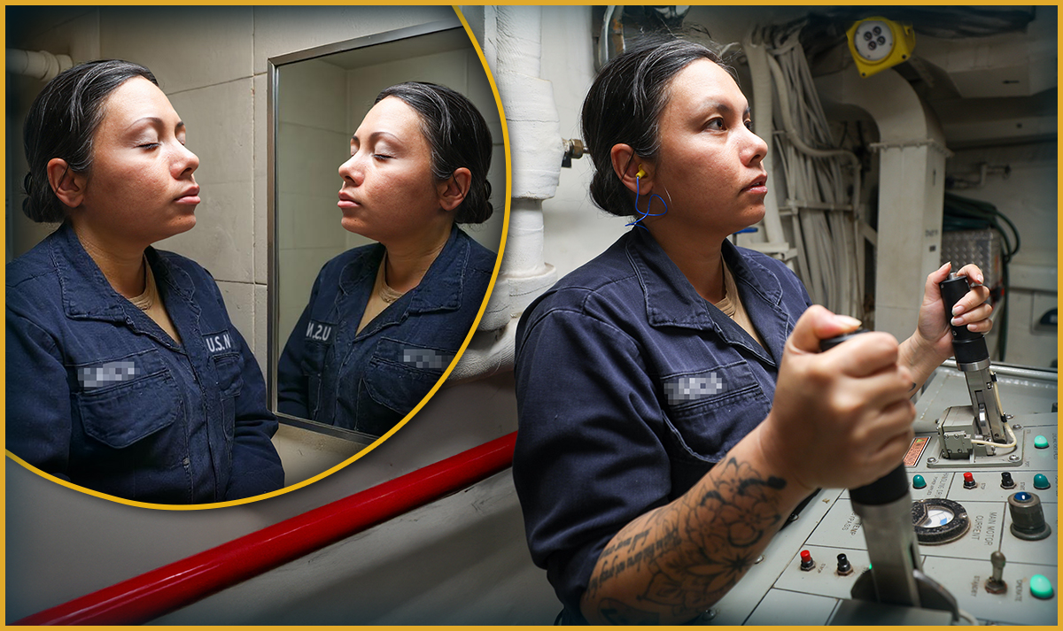
Mental Rehearsal
What is mental rehearsal?
Mental rehearsal is performing a task in your mind in a vivid and controlled manner. The mental imagery should incorporate all the senses and include overcoming challenges.
Notes:
Facilitator Actions:
Display slide.
Discuss how graphic relates to topic.
Monitor the discussions of the Sailors.
Facilitator Content:
Discuss:
Why do actors rehearse their lines before they say them?
How does rehearsing help the actors when the cameras are rolling?
What is mental rehearsal?
Inform:
This technique is used to prepare for real-life performance and improve your overall outcome by vividly imagining yourself successfully performing a controlled task or skill in your mind.
Mental rehearsal involves mentally simulating the desired outcome, the steps involved, and sometimes even the emotions or sensations associated with that task.
Mental rehearsal creates an emotional involvement in the Sailor as they rehearse the task or skill in a controlled environment.
The primary objective is to enhance performance by strengthening the neural pathways and fostering confidence, focus, and readiness.
To perform mental rehearsal successfully, it must be vivid and controlled.
Discuss:
How can athletes use mental rehearsal before a big game to improve their performance during it?

Slide 5
Mental Rehearsal Activity
“I’ve discovered that numerous peak performers use the skill of mental rehearsal or visualization. They mentally run through important events before they happen.”
- Garfield, Charles A., PhD, Peak Performance, 2021
Notes:
Facilitator Actions:
Display slide.
Read the script to the Sailors.
Monitor the discussions of the Sailors.
Allotted time for activity: 5 minutes
Facilitator Content:
Expected outcomes: Sailors will practice a breathing exercise, mentally walk through an event, plan their actions, think ahead to handle surprises, and visualize a successful outcome.
Discuss:
Now we are going to practice mental rehearsal.
This technique helps us prepare for unexpected events by imagining a scenario in detail. We will start with a brief relaxation exercise to clear our minds and focus.
Inform:
Instruct the Sailors to do the following:
Sit comfortably.
Close your eyes if you feel comfortable doing so.
Begin by taking a deep breath in through your nose for a count of five: 1, 2, 3, 4, 5.
Hold your breath for a count of two: 1, 2.
Exhale slowly through your mouth for a count of seven: 1, 2, 3, 4, 5, 6, 7.
Repeat the breathing cycle four times: Inhale... Hold... Exhale.
As you breathe, notice the tension leaving your body. Focus on feeling relaxed and ready to concentrate.
Now, imagine you are sitting in a room preparing to stand up in front of the division and talk about upcoming uniform changes. Picture your surroundings: the table in front of you, your chair beneath you, and your notes laid neatly in front of you on the desk.
Visualize the sound of the Sailors seated near you chatting quietly.
Mentally locate the front of the room.
Visualize your name being called to walk up to the front of the room. Feel your mind spin at the uncertainty of how your brief will be received. Imagine the feeling of your heart racing as your adrenaline increases. This is a natural response. Practice your breathing and remind yourself that you’ve prepared for this moment and you are ready. Feel your heart rate slow down as your adrenaline levels balance out.
Mentally rehearse your actions step-by-step:
Listen for your name to be called.
Gather your notes.
Breathe calmly, stand up, and move toward the front of the room.
Make eye contact with your audience.
Begin your brief on the upcoming uniform changes with confidence and clarity.
Visualize handling surprises:
Imagine your notes are not in order. Picture yourself calmly finding where to start without panicking.
If a question is asked and you don’t know the answer, imagine how you will respond.
Visualize yourself delivering the brief with calm, controlled actions that will ensure your success.
Remind Sailors:
This mental preparation helps you stay calm and act effectively during your brief.
The more you practice, the more natural these actions will become if you ever need to use them while presenting a brief to your division.
Reference:
Garfield, Charles A., PhD, Peak Performance, 2021

Slide 6
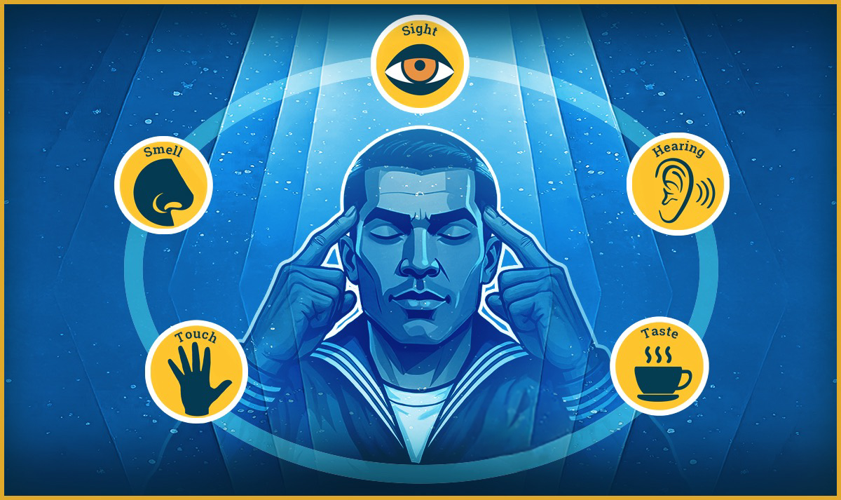
Vivid Visualization
Vivid visualization is important for achieving success in mental rehearsal.
Notes:
. Facilitator Actions:
Display slide.
Discuss how graphic relates to topic.
Monitor the discussions of the Sailors.
Facilitator Content:
Discuss:
What are your five basic senses?
How can you use these senses to mentally rehearse a task?
What is vivid visualization?
Inform:
Vivid visualization means incorporating all of your senses and body sensations that may occur when imagining yourself performing a task or skill.
You can prepare your mind and body by vividly imagining what you can expect to touch, smell, see, hear, taste, or feel during the experience.
Realizing that you don’t have to physically perform the task, but rather mentally imagine it, gives you the ability to single out and focus on each expected sense or sensation that may occur while performing the task.
Vivid visualization works best in a location that is free of distractions or noises that will prevent you from being able to fully experience the imagined senses and sensations around you.
By using all your senses, you can enhance the mental representation of muscle memory and perform better, even when your heart rate increases, your adrenaline is pumping, and you are in a high stakes situation.
Discuss:
What are the benefits of vividly visualizing a task before you perform it?
If you were to imagine a task at sea while on deck or on land in a workshop, which senses and sensations could you experience?

Slide 7

Controlled
Mental rehearsal needs to be controlled to ensure it is effective and produces positive outcomes.
Notes:
Facilitator Actions:
Display slide.
Discuss how graphic relates to topic.
Monitor the discussions of the Sailors.
Facilitator Content:
Discuss:
What is an example of a task you performed unsuccessfully and wished you could do over again?
What made you realize after the fact you could have done it a better way?
How did performing it incorrectly cost you time or money you did not expect to lose?
What would you have done differently?
How does the word controlled relate to mental rehearsal?
Inform:
Controlled means visualizing yourself performing actions or steps before you actually do them.
Before you begin to visualize, stay calm and focused to maximize your success.
Imagining a controlled scenario includes mentally working through any obstacles, fears, or challenges and finishing the task successfully.
It is important to include the emotions attached to performing each task and acknowledge your feelings during practice to desensitize unpleasant events.
When you mentally rehearse in a controlled environment, you can solve problems and discover new solutions without wasting time or resources.
Remember to utilize positive self-talk when overcoming challenges or fears during mental rehearsal. This inner voice provides a way for the brain to interpret and process positive outcomes before they happen.
Discuss:
What is a skill or task that would benefit from mentally rehearsing before trying to complete it?
How would mentally performing the steps in your mind before physically trying to accomplish them help you to be successful?

Slide 8
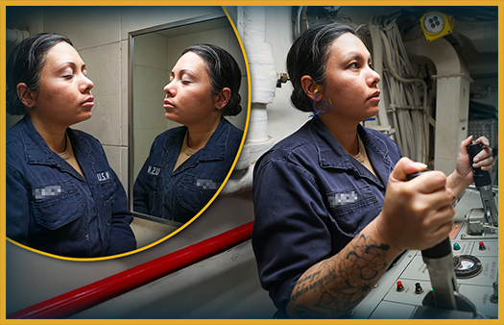
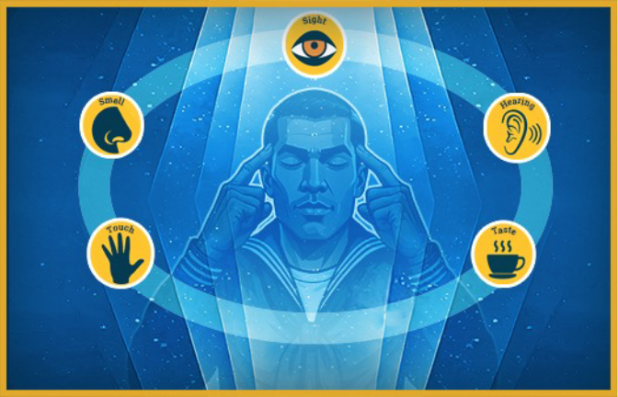

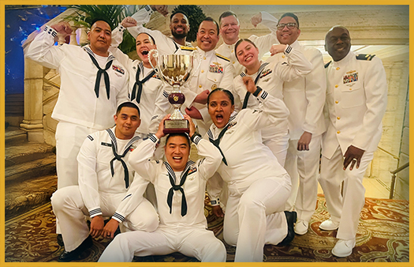
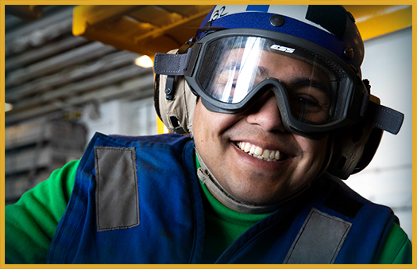
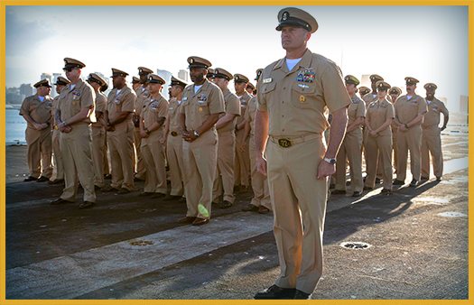
Mental Rehearsal Process
What is the most effective way to harness the power of mental rehearsal?
Visualize the scenario.
Include multiple senses.
Control your actions.
Incorporate your emotions.
Use positive self-talk.
Practice frequently.
Notes:
Facilitator Actions:
Display slide.
Discuss how graphics relate to topic.
Monitor the discussions of the Sailors.
Facilitator Content:
Discuss:
What is the most effective way to harness the power of mental rehearsal?
Inform:
Now that you’ve learned how to vividly visualize and imagine your controlled actions, it is time to put them all together.
Let’s look at the process to successfully perform mental rehearsal:
Vividly visualize the scenario.
Ensure you are free from distractions.
Choose technical or physical activities.
Include multiple senses and sensations.
Remember the smells, taste, sight, sound, feeling, and any other sensations that may occur while imagining the steps or actions.
Control your actions.
Imagine accomplishing each step or action in the order you would perform it.
Plan your controlled responses to each step or action.
Work through any problems and overcome any obstacles.
Incorporate your emotions and remember how each step or action makes you feel as you attempt it.
Use positive self-talk to replace any negative thoughts with positive ones to improve self-esteem and confidence.
Visualize yourself completing the task successfully.
Practice frequently.
Before starting a difficult task, remember to practice mental rehearsal.
The more you practice, the more naturally you'll begin to mentally rehearse before taking on new or challenging tasks.
Be consistent.
Discuss:
What steps or actions are you going to practice first using mental rehearsal?

Slide 9
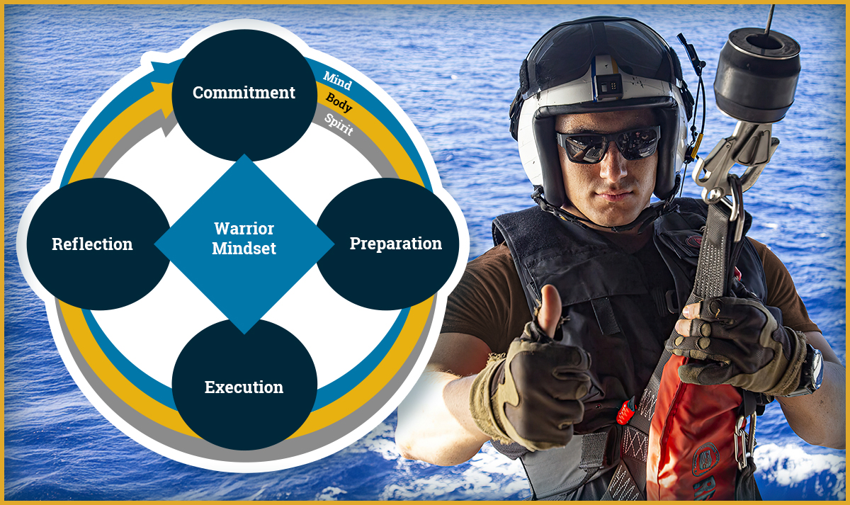
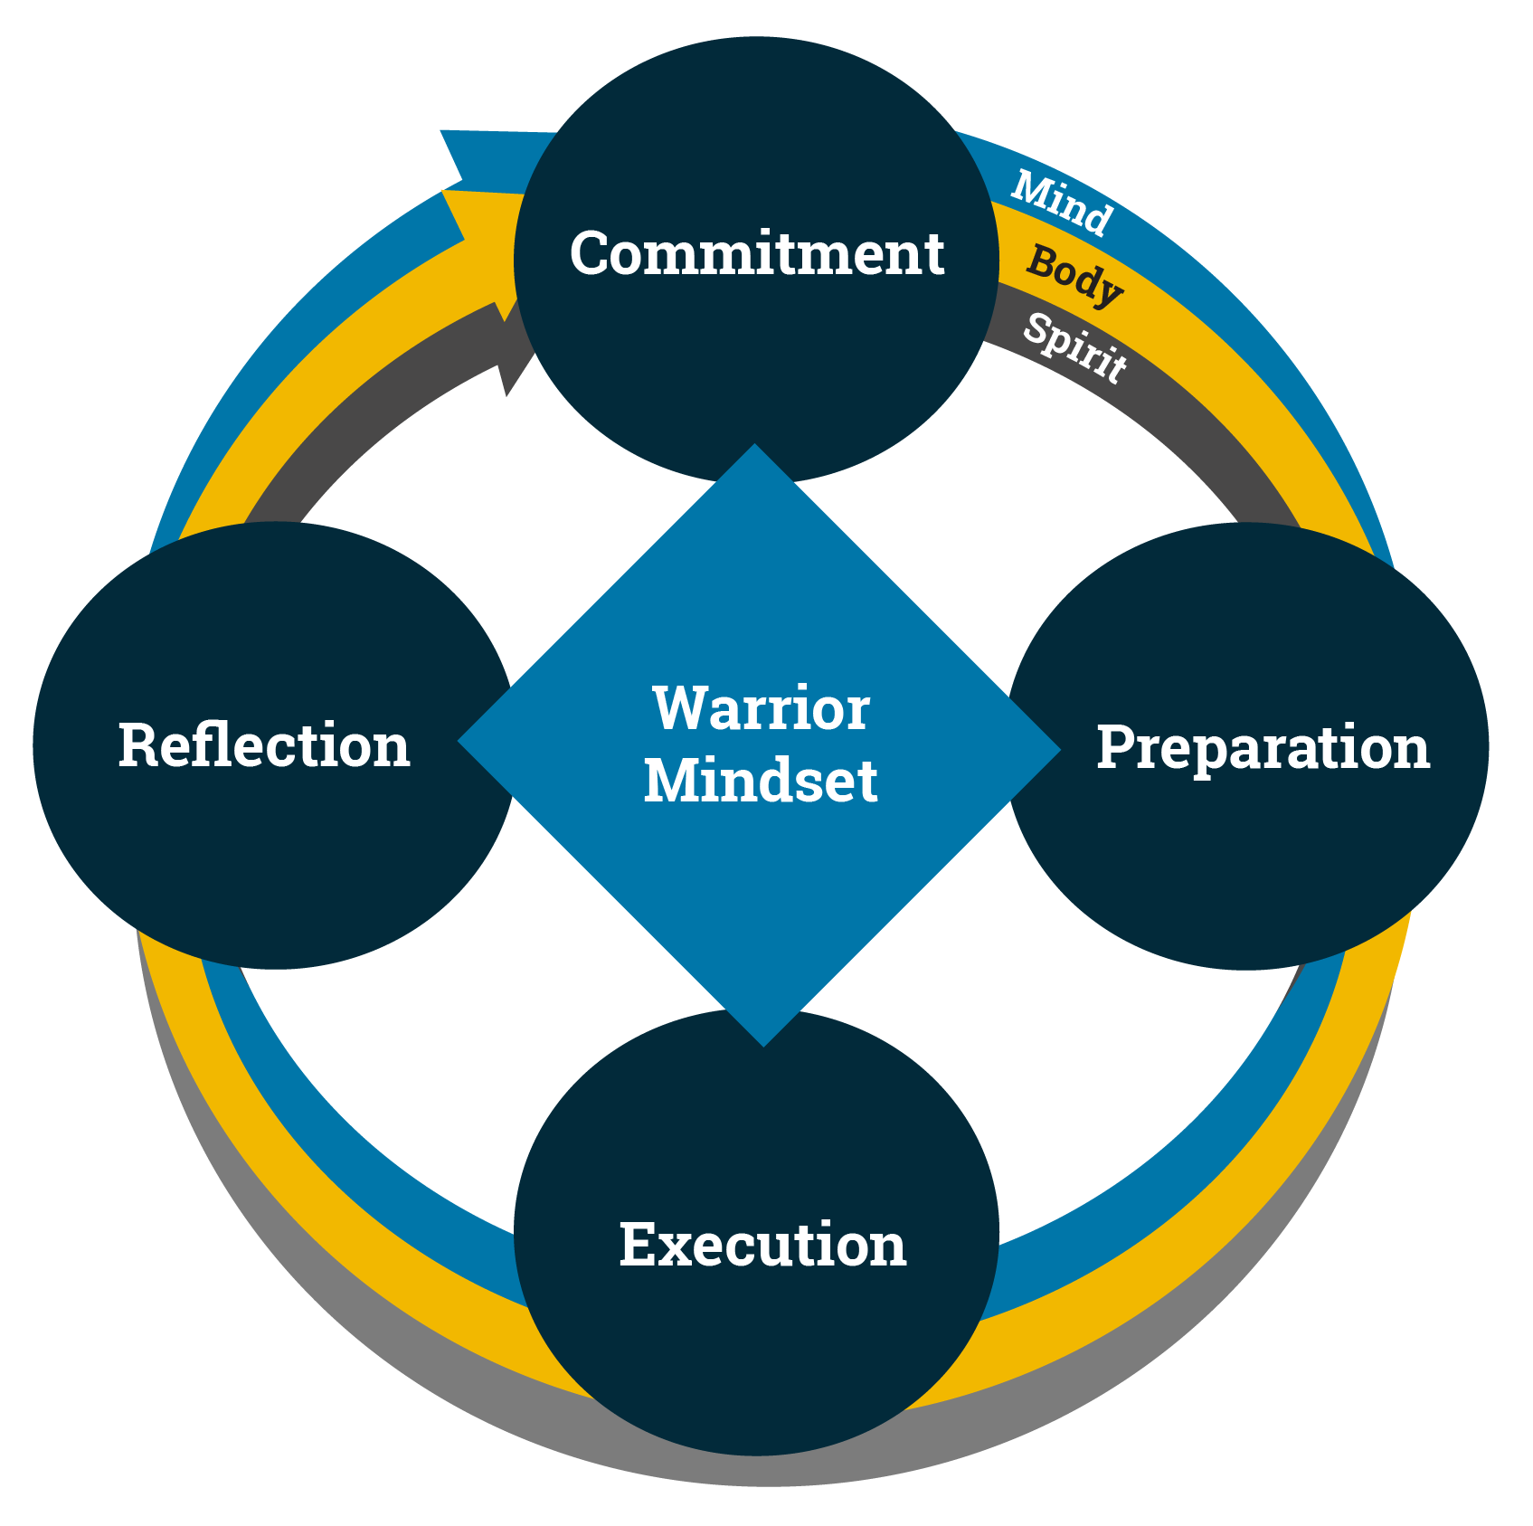
Unlock Your Warrior Toughness With Mental Rehearsal
How does mental rehearsal support the Warrior Mindset?
Mental rehearsal:
Improves performance
Prevents complacency
Boosts confidence
Notes:
Facilitator Actions:
Display slide.
Discuss how graphic relates to topic.
Monitor the discussions of the Sailors.
Facilitator Content:
Discuss:
How does mental rehearsal support the Warrior Mindset?
Inform:
A moderate amount of anxiety could be considered beneficial in certain situations.
Mental rehearsal improves focus, decision-making, and task execution. It helps individuals anticipate challenges and rehearse responses, ensuring they are prepared when the situation arises.
Regular mental rehearsal reinforces a proactive mindset, helping to prevent complacency in routine and high-stakes environments.
By visualizing success, individuals increase self-confidence and reduce anxiety, which improves their overall performance.
Long-term memory retention is improved by elaborate rehearsal, which combines newly learned information with previously learned information.
Keeping information in working memory and connecting new information to what is already known entails the purposeful and conscious repetition of information.
Discuss:
What can you do to prepare yourself in the future?

Slide 10
Visualizing Success: Mental Rehearsal in Action
CLICK TO DOWNLOAD VIDEO
(DVIDS VIDEO)
Open in your browser to download from DVIDS
Notes:
Facilitator Actions:
Display slide.
Select Play or use the Enter key to view the video.
Use the ESC key to return to the smaller size.
Let Sailors know where they can locate references.
Monitor the discussions of the Sailors.
Facilitator Content: N/A

Slide 11
Real-World Applications Activity
Where can mental rehearsal help you prepare for a challenging or unexpected event in your life?
Notes:
Facilitator Actions:
Display slide.
Monitor the discussions of the Sailors.
Time allotted for activity: 10 minutes: 1 minute (prepare), 5 minutes (discussion), 4 minutes (reflection/group share)
Facilitator Content:
Expected outcome: Sailors will be able to identify a scenario and how they would benefit from using mental rehearsal before performing it.
Inform:
Instruct the Sailors to work with a partner.
Tell them that together, they will discuss a situation where mental rehearsal could help them prepare for a challenge or unexpected event in their life (at home, work, or elsewhere).
Discuss:
Where can mental rehearsal help you prepare for a challenging or unexpected event in your life?
Perform:
Each pair discusses the question.
After 5 minutes, ask each pair to briefly share one scenario they discussed and how mental rehearsal could apply.
Inform:
When all partners are done sharing, provide a debrief and remind Sailors that the goal of mental rehearsal is to visualize situations in your mind, using as many senses as you can to make them as realistic as possible, and then imagining successful completion of the steps or actions.

Slide 12

Call to Action
Train your mind like you train for your mission!
Notes:
Facilitator Actions:
Display slide
Review topics discussed and ask if there are any questions.
Check Sailor comprehension by providing review questions and/or problems.
Discuss how the call to action supports and encourages Sailors’ post training.
Relate call to action to Warrior Toughness.
Facilitator Content: N/A

Slide 13
References
Tools and Resources
Rutgers Cooperative Extension's "Put Your Mind to It" Workbook: https://njaes.rutgers.edu/sshw/workbook/03_Put_Your_Mind_to_It.pdf
Peak Performance, Garfield, Charles A., PhD, 2021
Warrior Toughness Placemat
Notes:
Facilitator Actions:
Display slide.
Facilitator Content:
Inform:
Identify tools.
Identify resources.

Slide 14
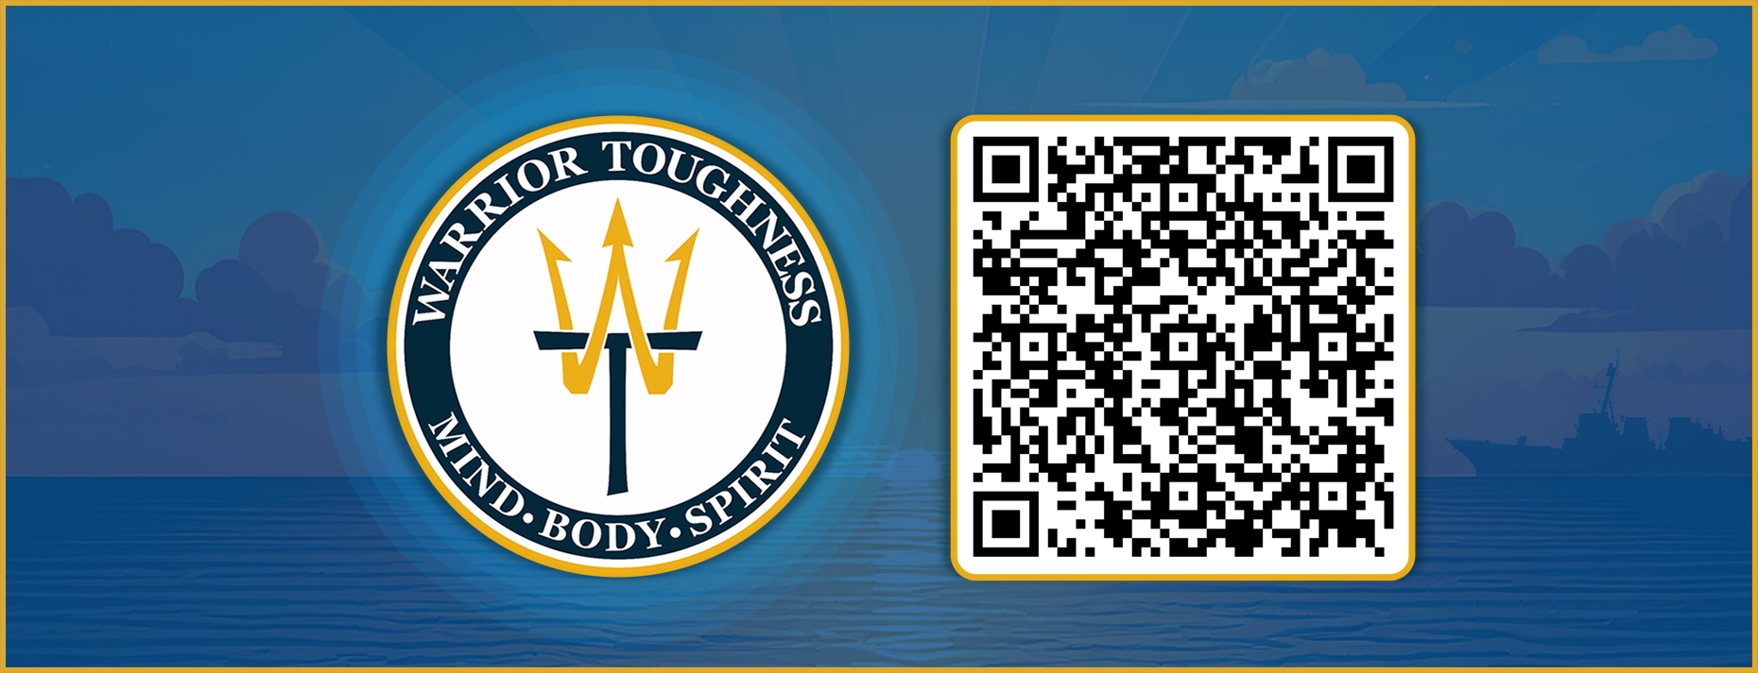
Warrior Toughness QR Code
Notes:
Facilitator Actions:
Display slide.
Facilitator Content:
Inform:
Identify Warrior Toughness QR code.

Slide 15
Glossary
Glossary
Abbreviation | Term
WT | Warrior Toughness
Notes:
Facilitator Actions:
Display slide.
Facilitator Content: N/A

